Slide 1
Welcome to R/Medicine 101: Intro to R for Clinical Data
Rich Hanna
R/Medicine 2026
Notes:
Start 11:02 AM
Hello and welcome to the R/Medicine pre-conference workshop Intro to R for Clinical Data!

Slide 2
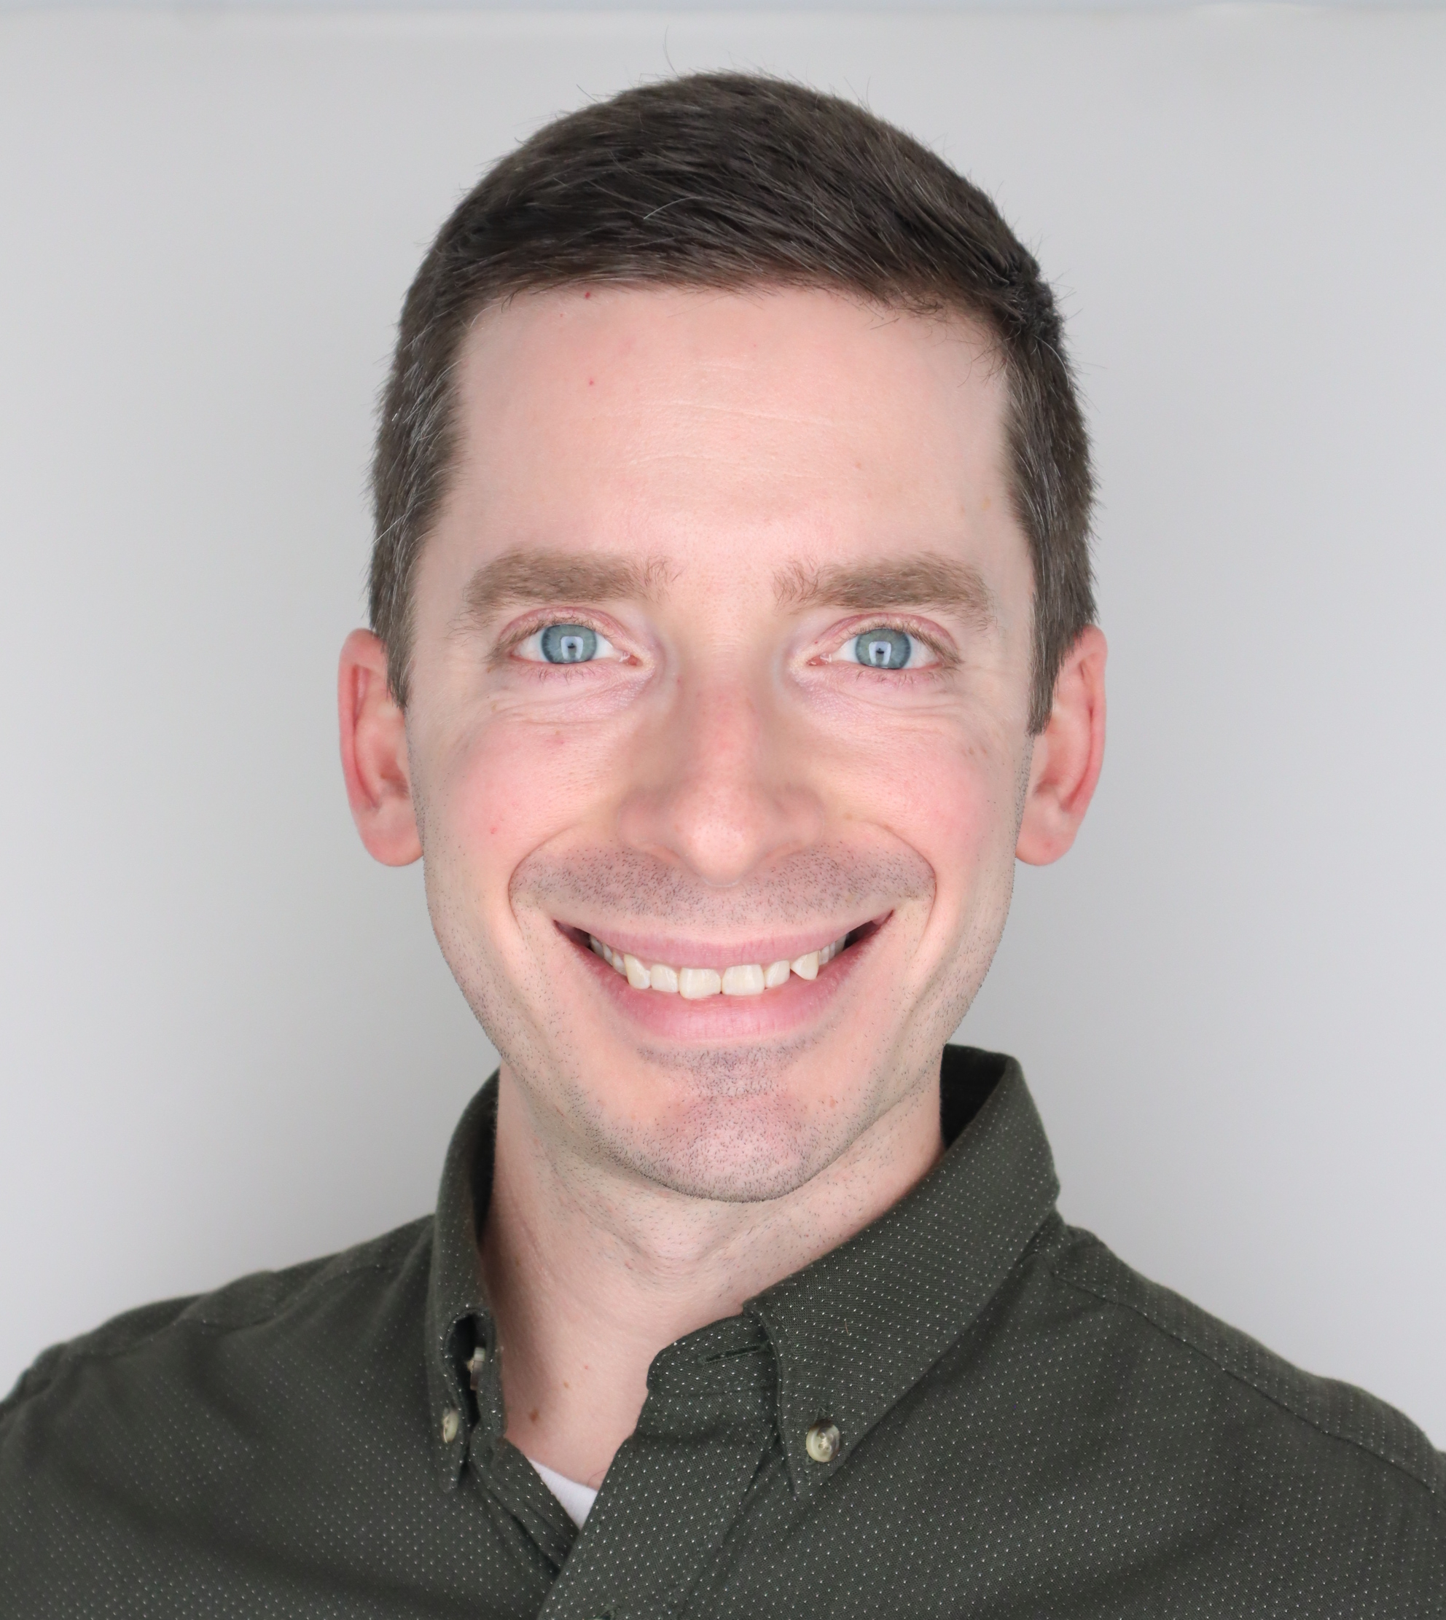
Rich
Notes:
My name is Rich Hanna, I am the data science manager for cell and gene therapy informatics at the Children’s Hospital of Philadelphia.
I have been programming in R for about 8 years now in the medical space, with a background in biomedical and mechanical engineering.

Slide 3
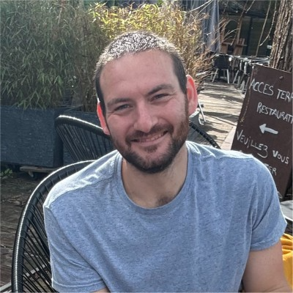
Ezra
Notes:
I’m joined today by Ezra Porter. Ezra is also on the CGT Informatics team and our lead data scientist. He has a background in statistics and is instrumental in our team’s model development and application design and has extensive R programming experience.

Slide 4
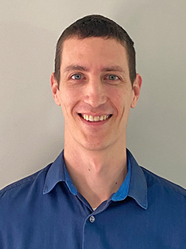
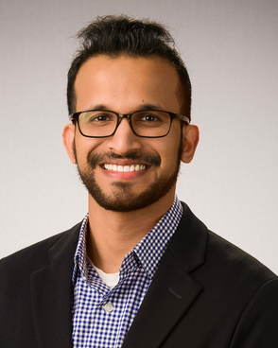
Introducing the TAs!
Alex Peters
Roni Devassy
Notes:
We’re also fortunate today to have several TA’s who will be available to monitor the chat. Alex Peters and Roni Devassy are systems analysts from the CGT informatics team who can help you with any issues you might be experiencing.

Slide 5
Orientation to the Technology

Slide 6

Main session vs Breakout rooms
Webinar-style
100+ participants
Mic off
Camera off
Meeting-style
10-15 participants / room
Mic on
Camera optional
Notes:
The main part of the workshop will be webinar style, with everyone in one big session, and participants will be muted and cameras off. We are recording the main session for replay.
We will have one or two breakout sessions. For the breakouts, we encourage you to participate by turning on your microphone. We also encourage you to turn on your camera, if you are comfortable, but that's completely up to you. We won't record breakout sessions.

Slide 7
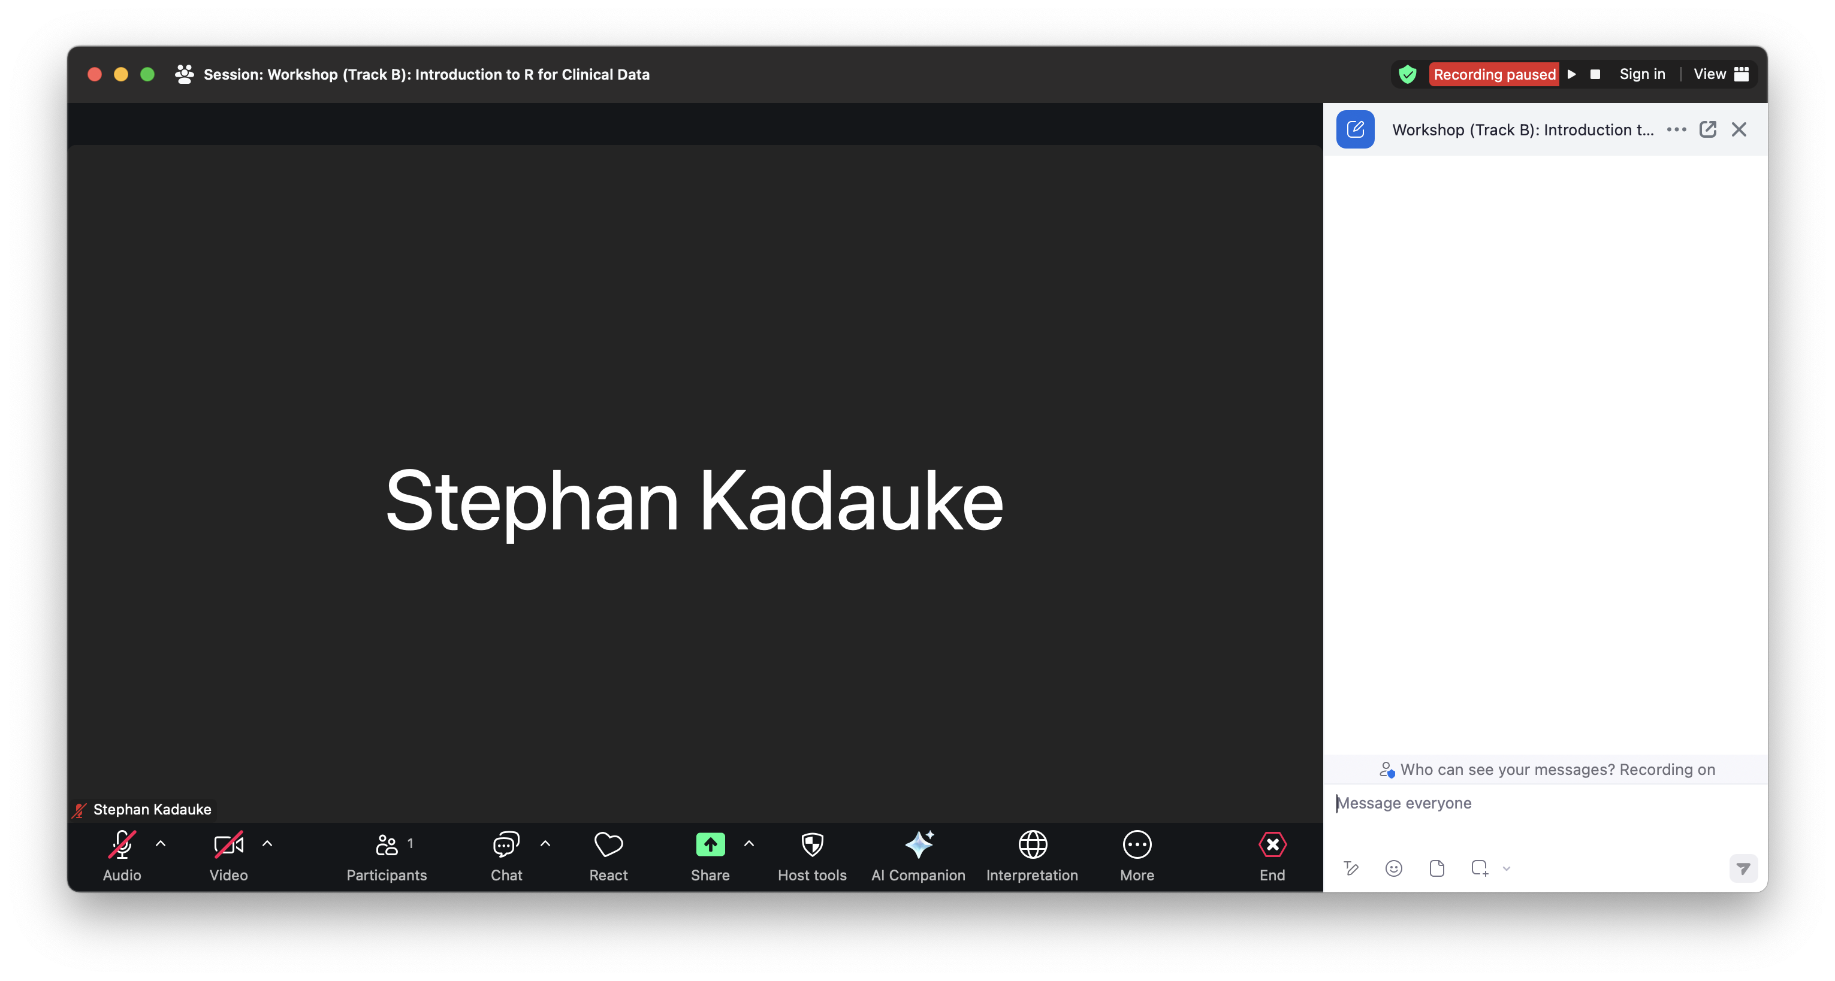

Notes:
This is the main Zoom window, it may look s. On the bottom you should be able to see a bunch of buttons.
Click on the Chat to open the Chat window, which should then open up at the side.

Slide 8
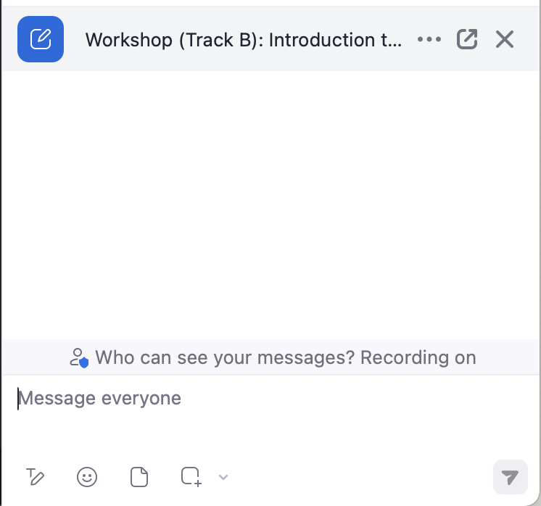
Chat window
Notes:
We will use the Chat window as the primary communication tool, primarily to get help if you get stuck with a technical issue. Please note that the presenter can't present and monitor the chat at the same time. So if you send me any private messages while I’m presenting I will probably not see it and so I won’t respond. Instead, post to Everyone, briefly describing the problem you have, and one of our TAs will help you.
I also want to set expectations for help here. We have more than X participants today, and so please only ask for help if you need technical assistance with Zoom or the posit cloud training environment. If you have a more general question about the material, we encourage you to write it down and ask during the breaks, or after the workshop.

Slide 9
Your Turn #1
Write your location (city, country) in the Chat window.
Notes:
This brings us to the first interactive exercise!
...

Slide 10
Orientation to the Course

Slide 11
The Data Analysis Pipeline
Notes:
This in a gentle introduction to data science designed for healthcare professionals and clinical researchers who don't have a background in programming. This slide shows a high-level conceptual framework of the most important steps of the data analysis process. You always start by importing data and cleaning or "tidying" it up. Then you start an iterative process of exploratory data analysis, which usually requires some data transformation. The main ways you gain knowledge from your data are visualization and modeling. Finally, you need to communicate your results.
We will introduce the basics of all of these steps today, with the exception of modeling because that’s a bit out of scope for this very basic intro course.

Slide 12
Lecture slides
Notes:
We will introduce new concepts with lecture slides

Slide 13
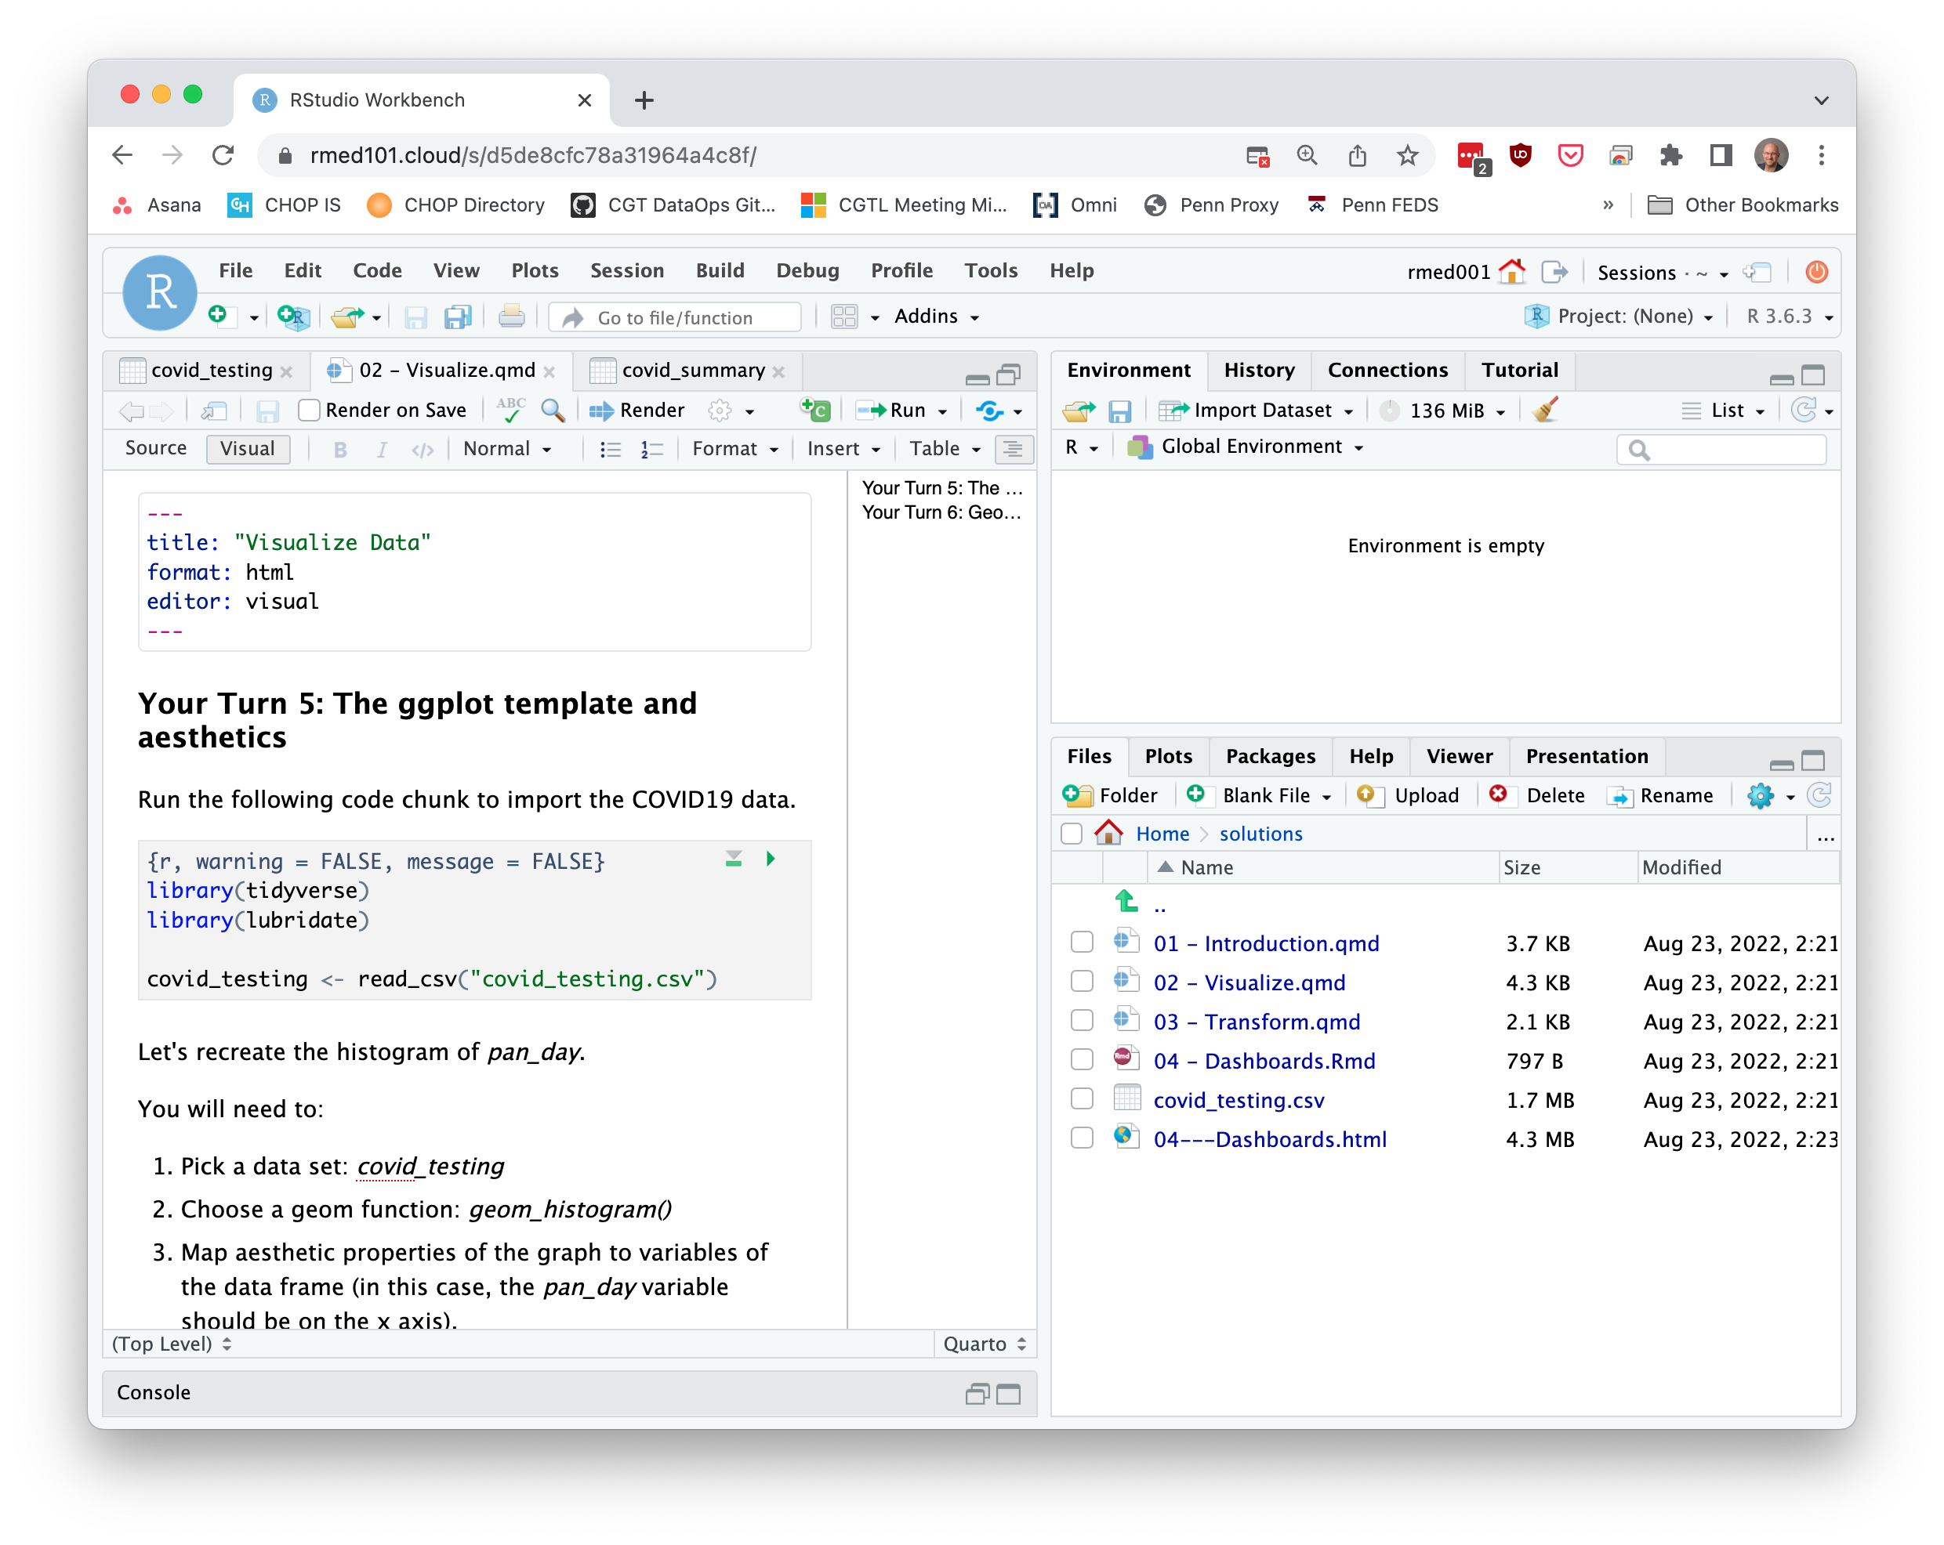
Timed interactive coding exercises
Notes:
And then practice these new skills with timed interactive coding exercises. You will work in a training environment on the web that we specifically set up for this course.
It's important to note that these exercises are timed. It's not essential that you finish each exercise, but it's essential that you try. When the time is up, we ask that everyone stop working and return to the main session. We will then live code the exercise to catch everyone up.

Slide 14
Code of Conduct
Screenshots
Recordings
Photographs
Harassment
https://rconsortium.github.io/RMedicine_website/Attend.html
Notes:
One more serious thing we need to point out, since this is an interactive course - we want to provide a welcoming and supportive environment for all people, regardless of background or identity.
** please take a look at the main website’s Code of Conduct tab https://rconsortium.github.io/RMedicine_website/Attend.html
** Also, to respect the privacy of participants, we don’t allow screenshots, recordings, or photographs.

Slide 15
Your Turn #2
Meet and greet! We will send you into breakout rooms, where you will have 5 minutes to meet 10-15 of your fellow participants.
Notes:
What I’d like you to do is, turn on your microphone and camera, if you’re comfortable. Go around the room and briefly introduce yourself and tell everyone what you’re hoping to get out of the workshop and the conference.
To keep things going, whenever someone is done speaking, they will “pass the baton” to someone else in the room. We’re tight on time, so it’s possible not everyone will go.
At the 5 min mark, we’ll bring everyone back into the main session.

